Slide 1
“Without it nothing moves”
10 November 2021
13:00-14:00 GMT
Hosted by
Notes:
Chris to check if we need to remove someone from the public

Slide 2
Please mute your microphone when not speaking.

Slide 3
Opening by Transport Decarbonisation Alliance (TDA)
Framing presentation
Moderated panel
Concluding remarks and presentation call for action
Agenda

Slide 4
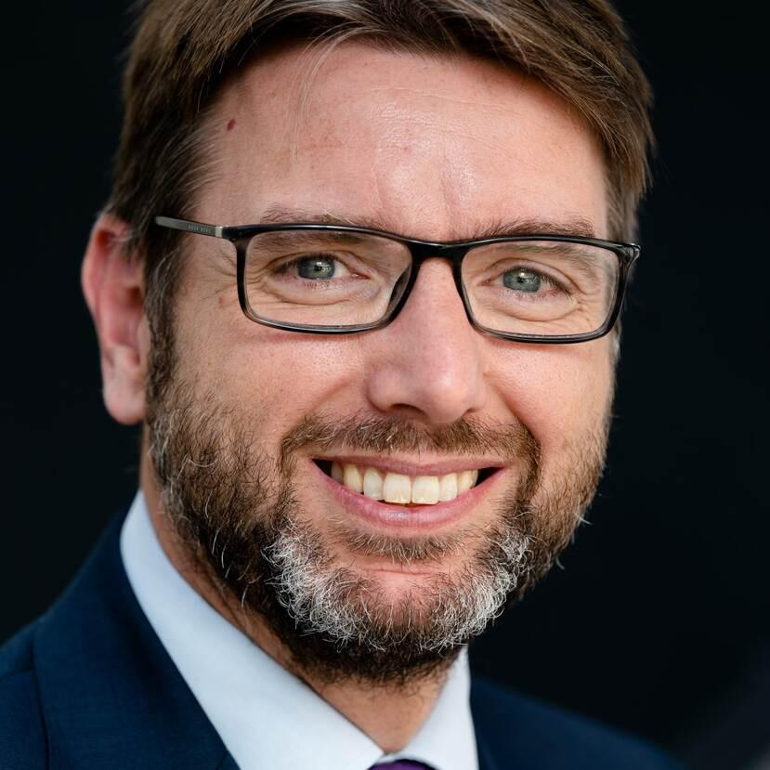
Opening Transport Decarbonisation Alliance (TDA)
Mr. Steven van Weyenberg
Minister for the Environment, the Netherlands
Ms. Liane M. Randolph
Chair California Air Resources Board

Slide 5
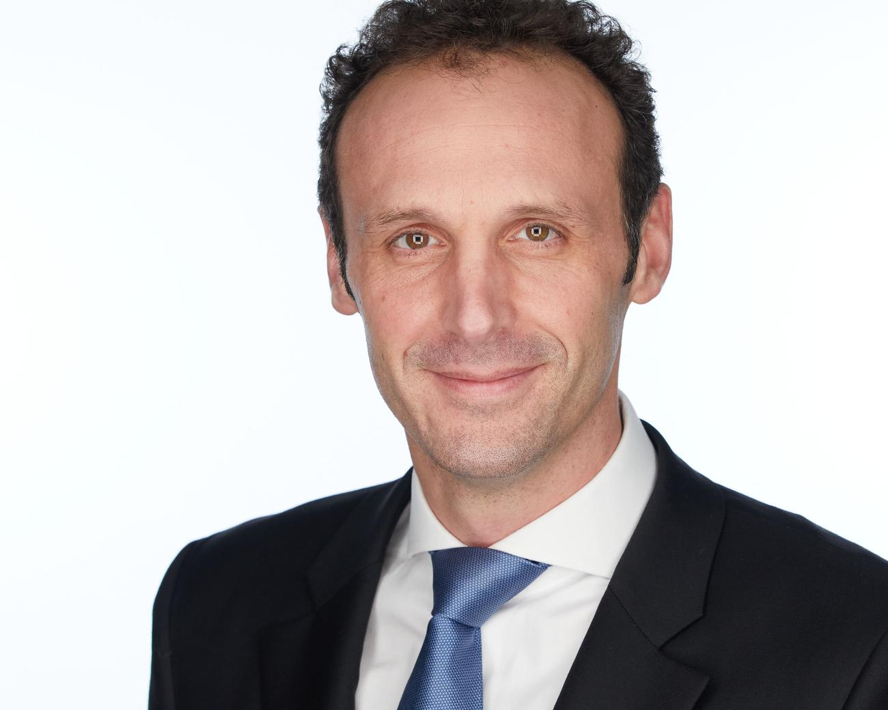
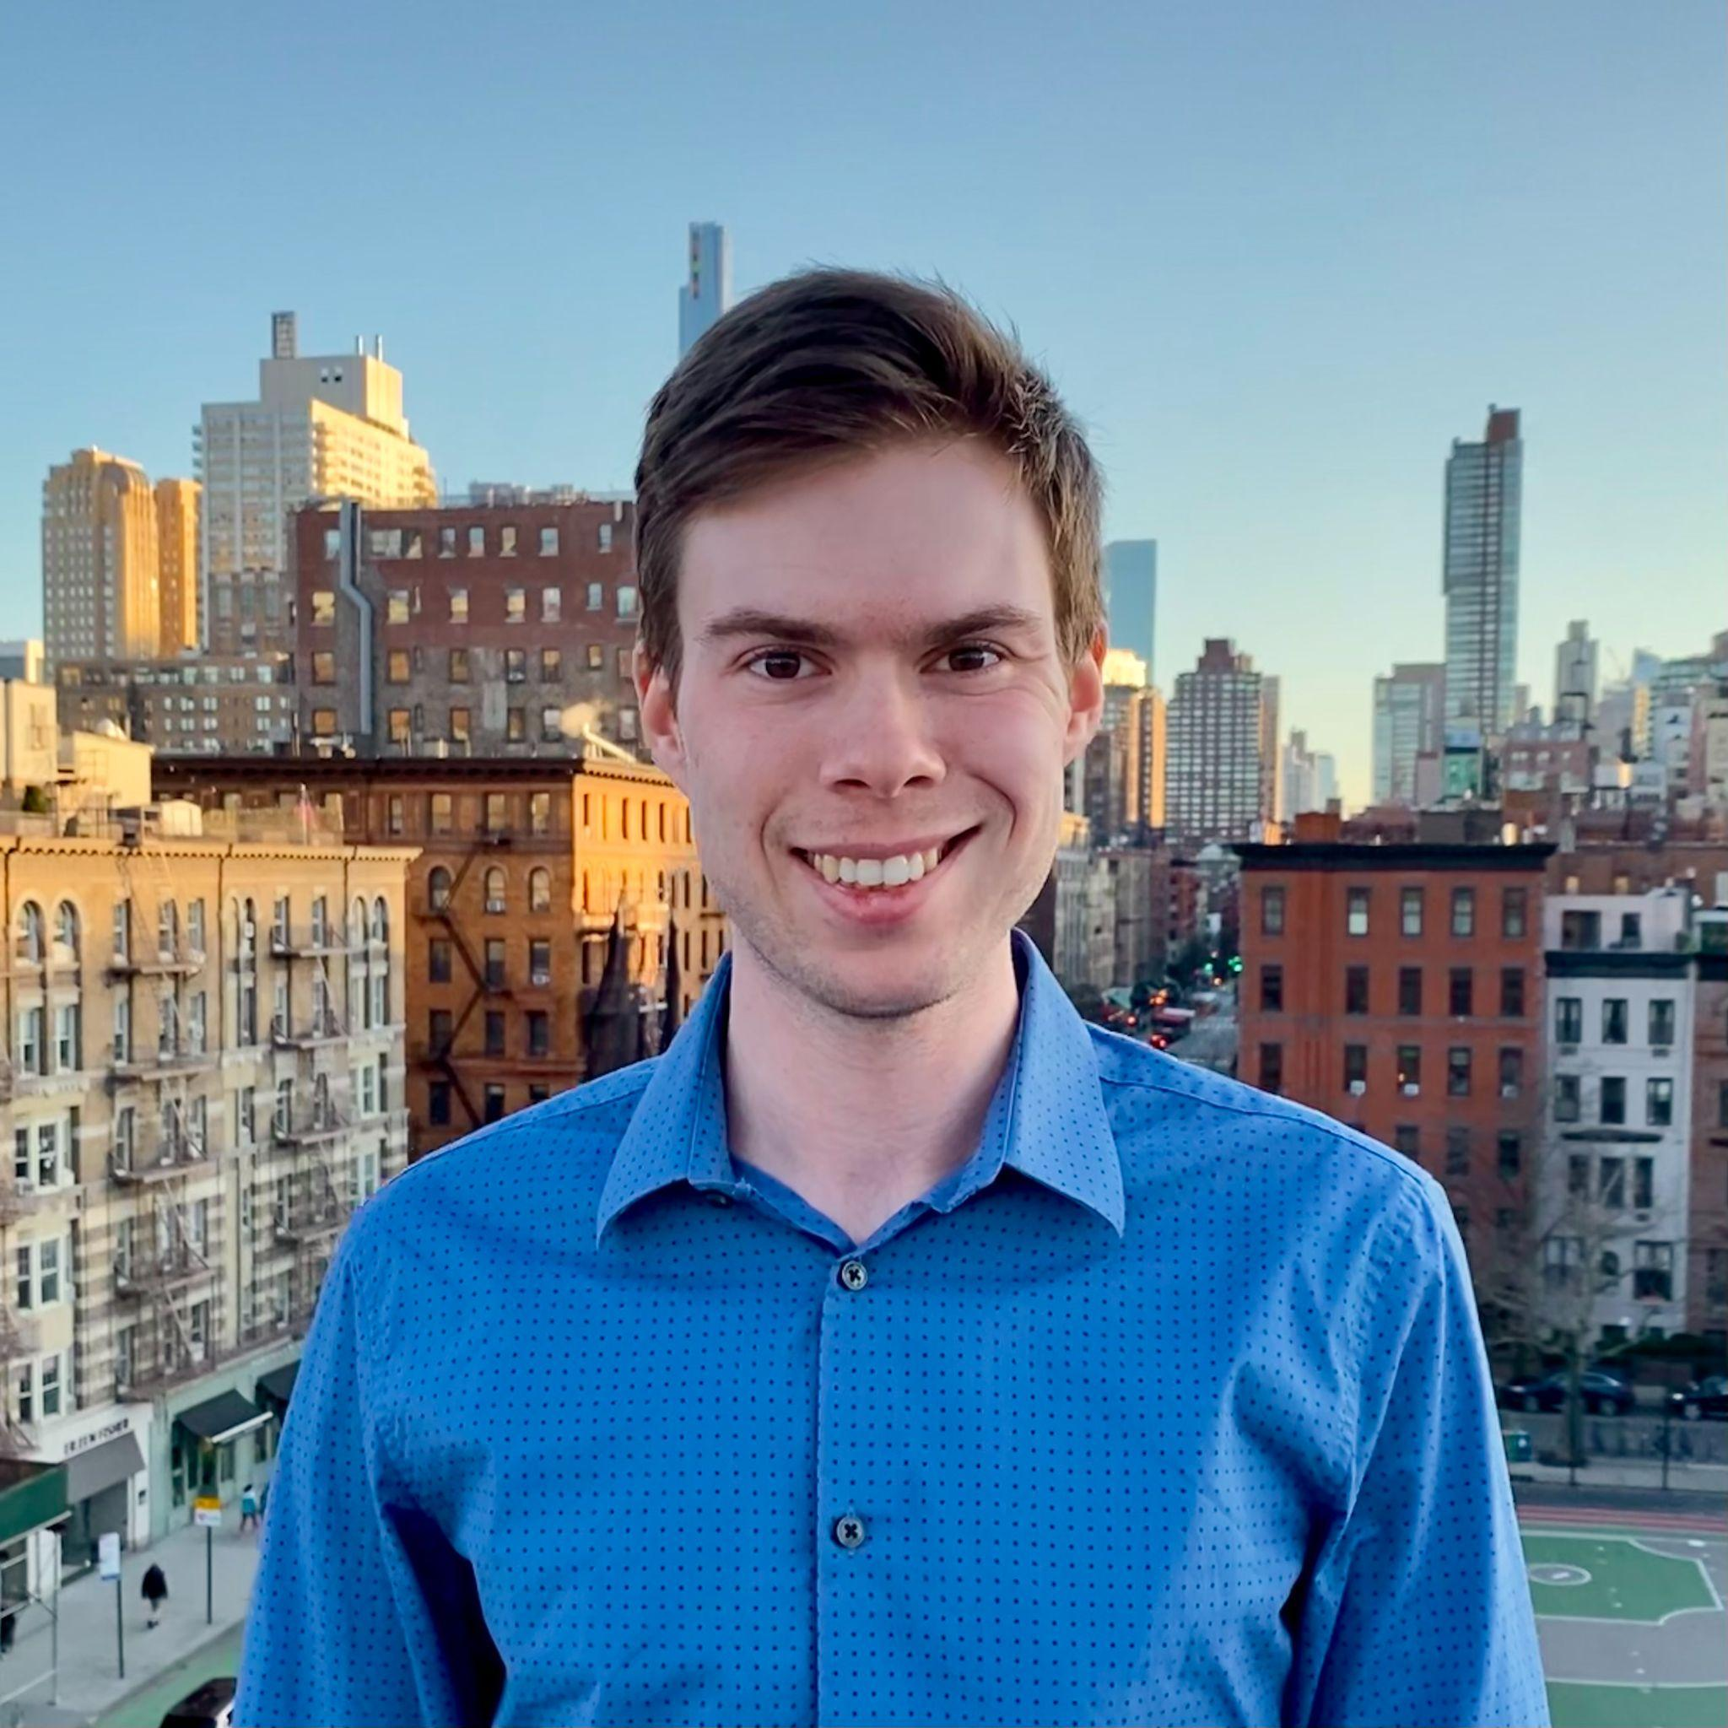
2. Framing presentation
Mr. Thomas Deloison
Director Mobility WBCSD
Mr. Dale Hall
Researcher ICCT’s Electric Vehicle Team

Slide 6
Without it, nothing moves Framing presentation: How much charging do we need to power the ZEV transition?
Dale Hall EV Researcher, International Council on Clean Transportation
10 November, 2021

Slide 7
Charging infrastructure is critical, but every country has different needs
The leading electric vehicle markets have the most public charging infrastructure per capita
Ratio of EVs per public charger vary widely from 3:1 in the Netherlands to 30:1 in California
Lack of clarity on future solutions limits private investment, grid preparedness

Slide 8
Good planning requires local analysis
Key inputs:
EV fleet projections
BEVs
PHEVs
Vehicle efficiency and range
Home charging access
Housing types
Policies for home charging
Travel behavior
VMT
Commuting patterns
Key outputs:
EV chargers
Public normal/Level 2
Public DC Fast/rapid
Private workplace
Multi-unit dwellings
Electricity demand
Hardware and installation cost
Every region, every year

Slide 9
Charger needs are high, but rate of growth is in line with current plans
All governments analyzed require 25-35% annual growth from 2020-2030
Workplace, DC fast, and curbside chargers particularly needed for mainstream market
Results align with government targets (e.g., France, U.S., London)
Charging infrastructure needs for Germany, 2021-2030 (private home charging not included)

Slide 10
Lessons for public and private sector
We’re on the right path, but the numbers will keep growing.
Lots of charging means there is room for all to help!
The future is uncertain, so track progress and update plans regularly.

Slide 11
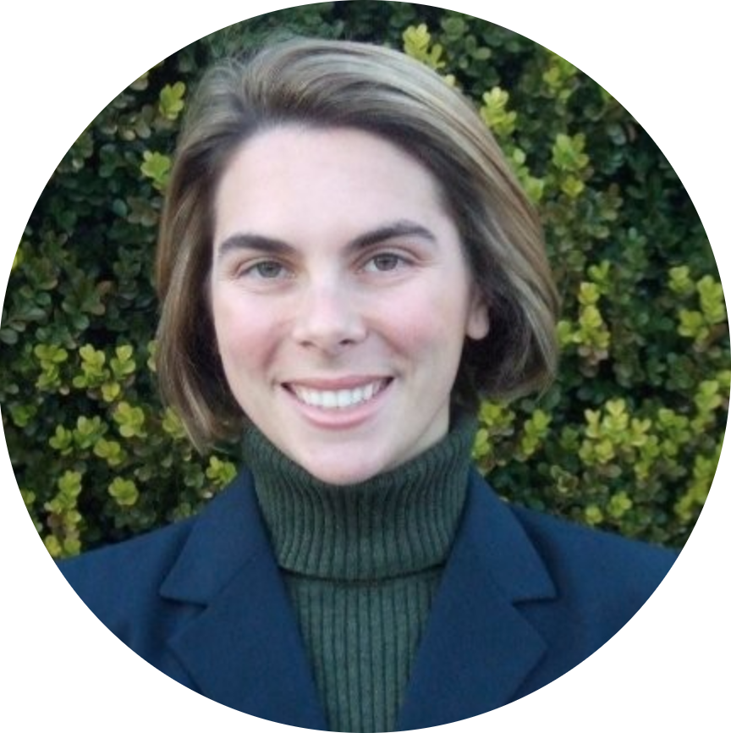
3. Moderated Pannel
Moderator
Dr. Sydney Vergis
Division Chief, California Air Resources Board.

Slide 12
Pannelists
Mr. Andreas Follér
Head of
Sustainability Scania
Mr. Isbrand Ho
Managing Director
Of Byd Europe B.V
Mr. Joachim Rosenberg,
Vice President And
Head Of Volvo Energy,
Volvo Group
Mr. Bram Poeth
Chief Commercial
Officer, EV Box
Ms. Sharon Dijksma
Mayor Utrecht,
Netherlands
Mr. Jeremy Hewitt
Assistant Deputy
Minister For Climate Change Strategy, British Columbia, Canada

Slide 13
4. Concluding remarks and presentation call for action
Ms. Liane M. Randolph
TDA Chair/California Air Resources Board Chair
Scan the QR Code with your phone to see the signatories

Slide 14
Thank you!

