Slide 1
Decarbonising Freight Transport
10 November 2021
14:30-15:30 GMT
Hosted by
Notes:
Chris to check if we need to remove someone from the public

Slide 2
Please mute your microphone when not speaking.

Slide 3
Introduction
An overview of Decarbonising Freight
How California is Supporting the Decarbonisation of Freight transport?
Transforming Supply Chains - Insights from Working with Shippers
Panel Discussion
Closing remarks
Agenda

Slide 4
Introduction
Morna Cannon
Head of Innovation and Acceleration, Transport Scotland

Slide 5
2. An overview of Decarbonising Freight
Alan McKinnon
Professor
Khune Logistics University

Slide 6
Decarbonising Freight Transport
Professor Alan McKinnon
Kühne Logistics University
Hamburg
Transport Decarbonisation Alliance
COP26
Glasgow
10 November 2021

Slide 7
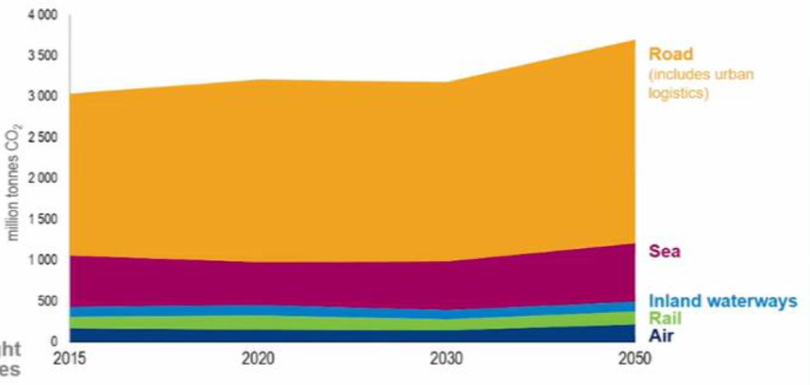
Scale of the Challenge
energy-related CO₂ emissions
lack of policy focus on freight decarbonisation
all transport
24%
freight = 40 % of transport emissions
freight = 9.6% of total CO₂ emissions
Over 150 Nationally Determined Contribution (NDC) statements ‘highlighted transport-related mitigation’
IEA / ITF data
freight transport CO₂ emissions by mode
‘only 13 NDCs communicated targets, policies or measures that directly address freight’
https://bit.ly/3bQJIFw
projected trends in freight transport CO₂
current policies
+22%
very difficult activity to decarbonise
almost total dependence on fossil fuel
high forecast growth of freight movement
2.6x increase in tonne-kms between 2015 and 2050 (ITF, 2021)
long life of freight assets (typical replacement rate in years)
Reshape+ scenario
-72%
van | truck | locomotive | ship | plane
5-7 | 10-15 | 25-30 | 30 | 30
2015
2050
source: International Transport Forum 2021
https://bit.ly/3fQ42YE

Slide 8
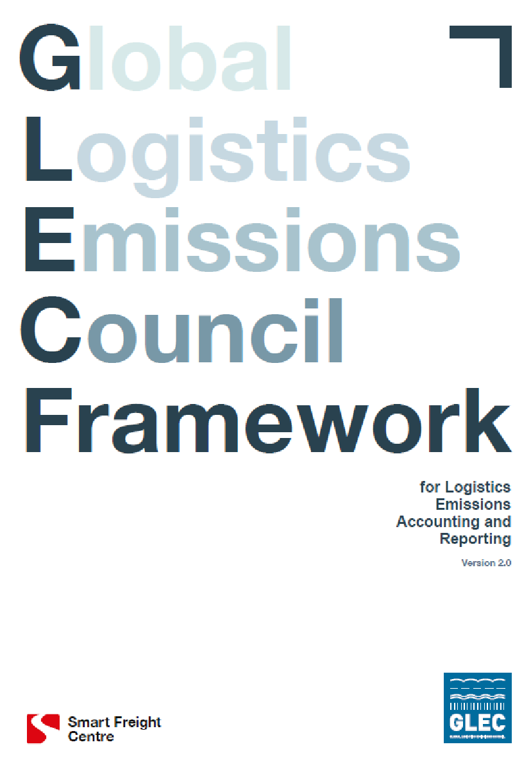
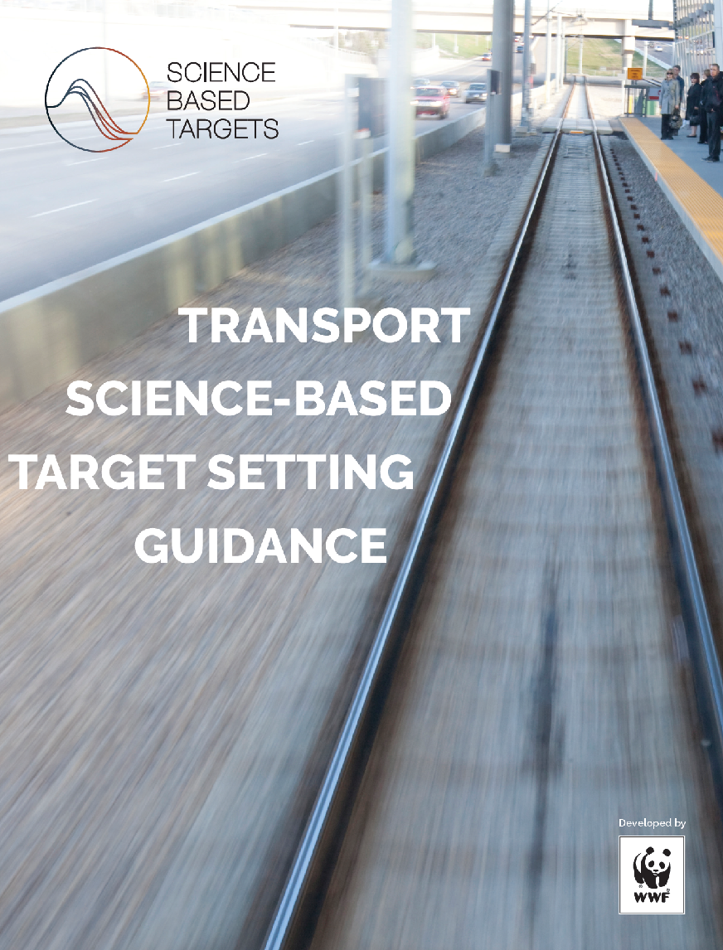
Developing a Strategy for Decarbonising Freight Transport
10 C approach
Corporate motivation
Calculate emissions
https://bit.ly/332rxrf
Consider possible options
Commit to targets
Collaborate with others
Cost evaluation
https://bit.ly/3bLieRF
Carbon offset
Choose appropriate actions
Cut emissions
Calibrate the strategy
https://bit.ly/37O2B8D

Slide 9
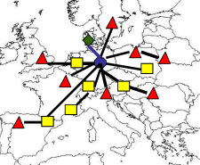
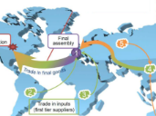
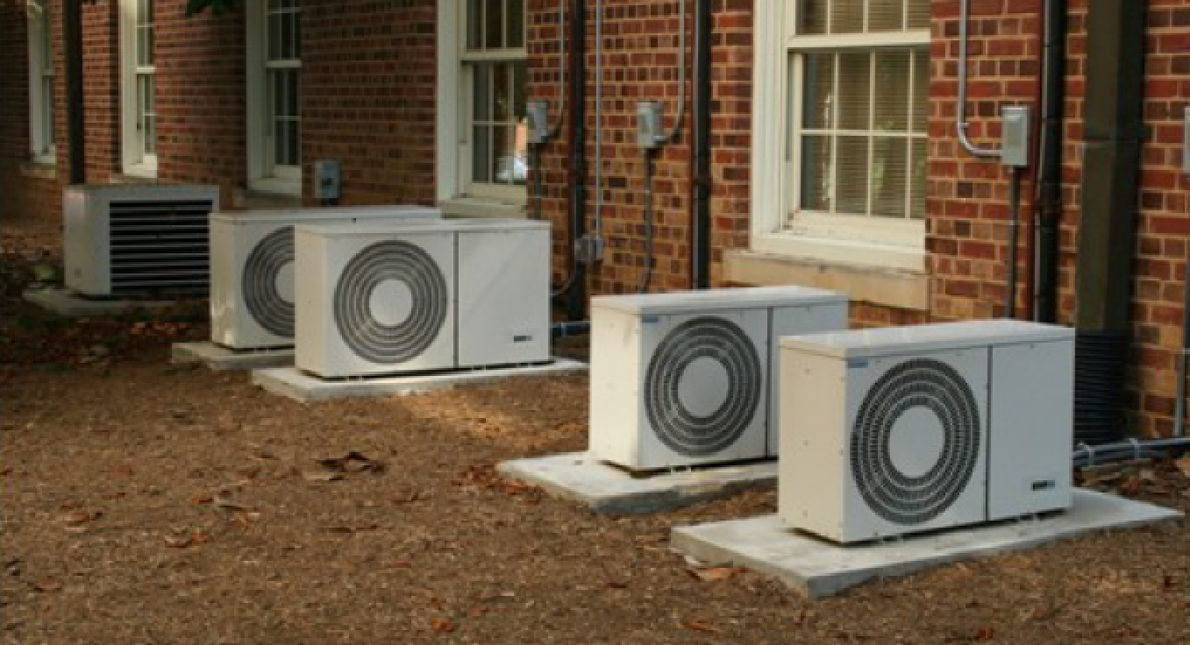
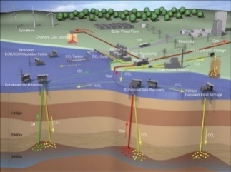
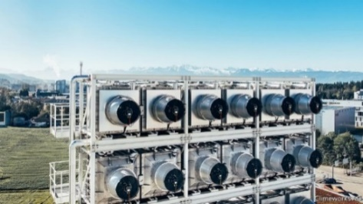
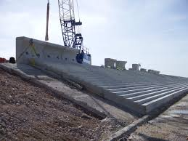
1. Reduce the Amount of Freight Movement
restructure supply chains
reshore / near-shore manufacturing
localize sourcing
decentralize production & inventory
phasing out fossil fuel – 30% of tonne-kms in 2020
Future freight traffic growth sectors
Reduce the amount stuff to be moved
renewable energy infrastructure
air conditioning / cold chain
carbon capture and storage
negative emissions
climate change adaptation
population resettlement
Notes:
‹#›

Slide 10
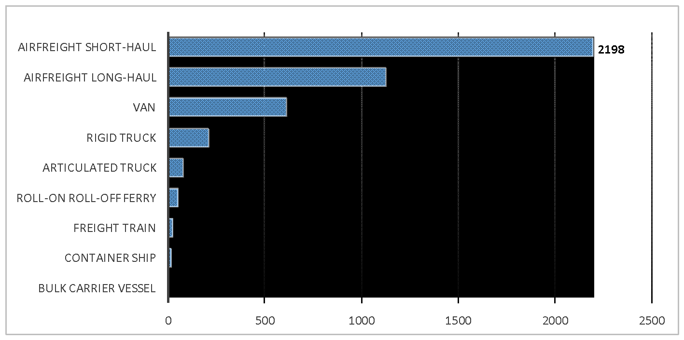
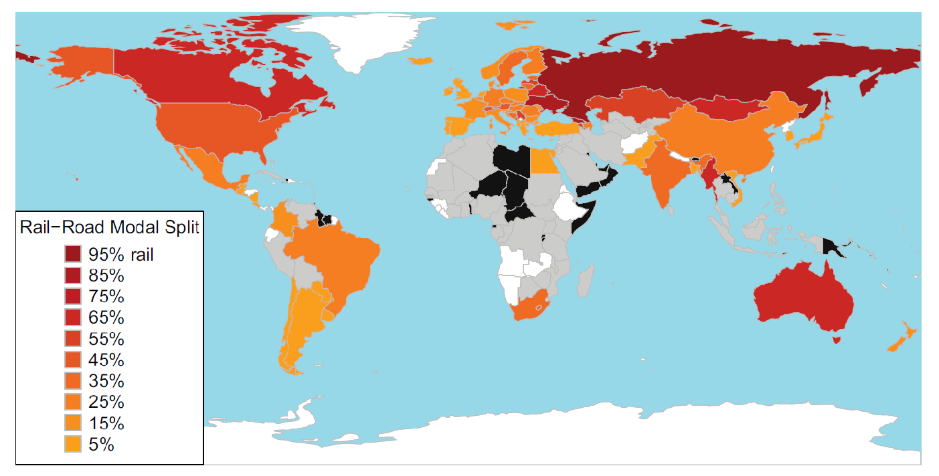
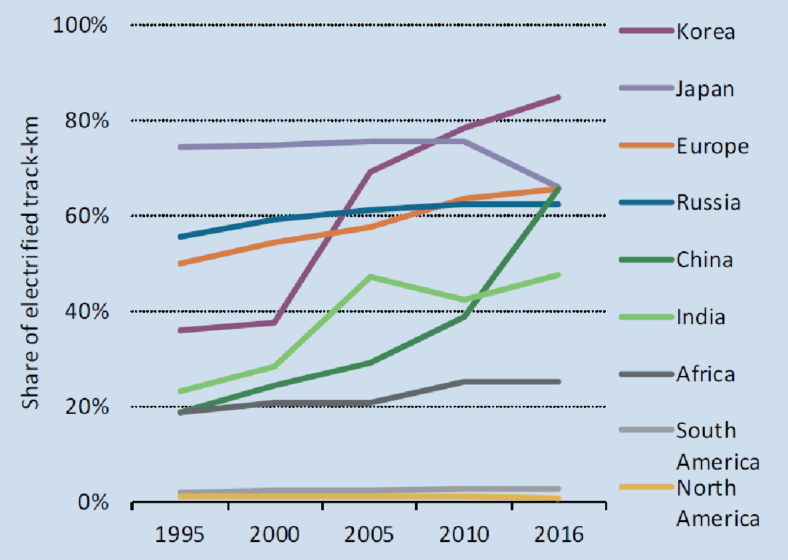
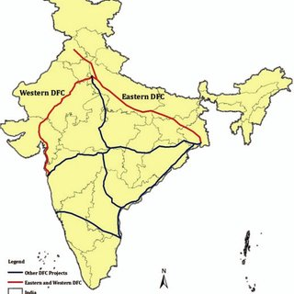
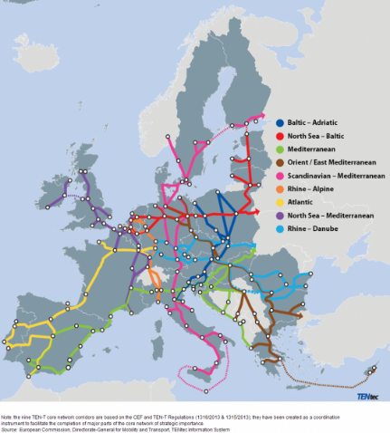
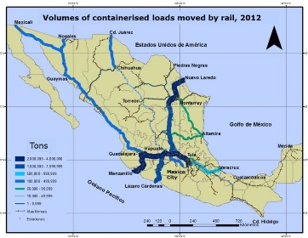
2. Shift Freight to Lower Carbon Transport Modes
average carbon intensity of freight transport modes: gCO₂ / tonne-km
International Variations in Rail-Road Freight Modal Split
source: DBEIS / DEFRA 2020
https://bit.ly/3b0UUhT
Source: Kaack et al (2018)
https://bit.ly/3pI6Mhk
difficult to reverse long term decline in railfreight share
decline in rail’s fossil fuel traffic – difficult to replace
% of rail networks electrified
policy and investment focus on intermodal freight corridors
Railway benefits from high % of network electrification – apart from North and South America
Globally, 50% of rail freight is electrically-hauled
https://bit.ly/3Emlbnu

Slide 11
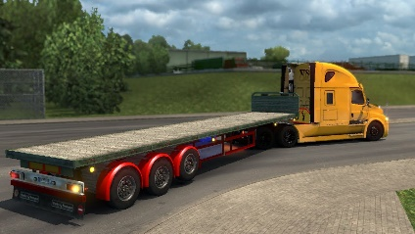
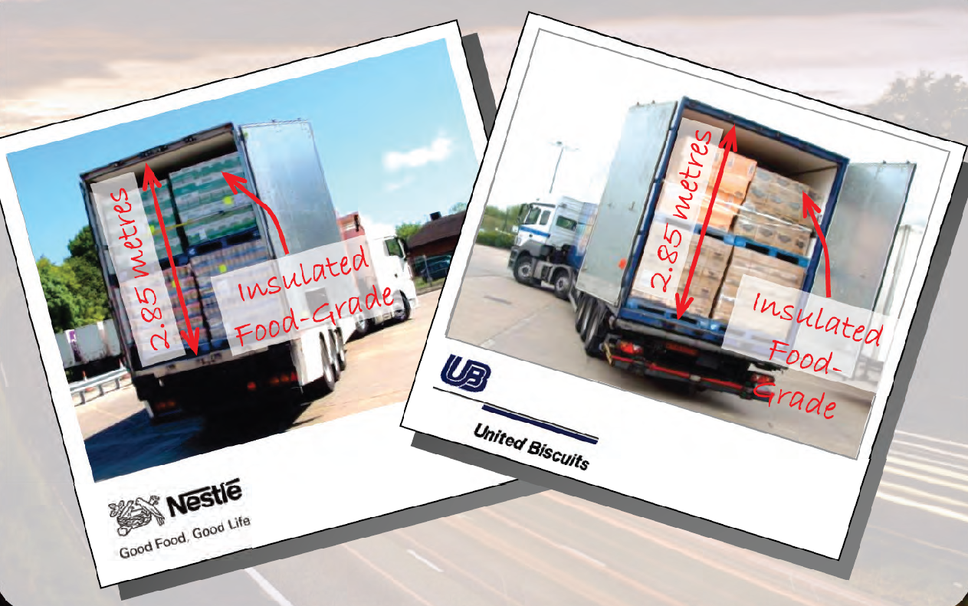
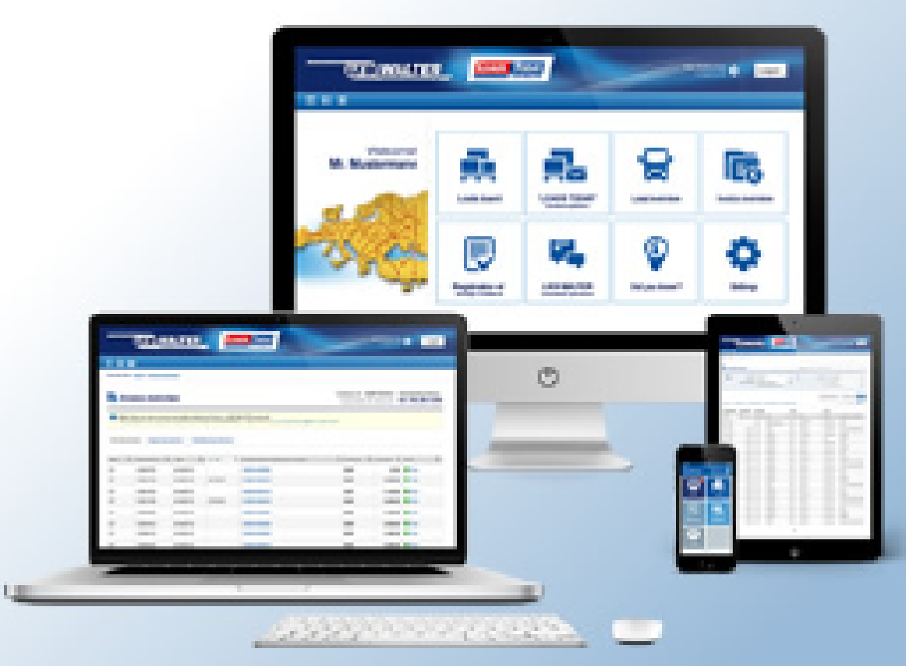
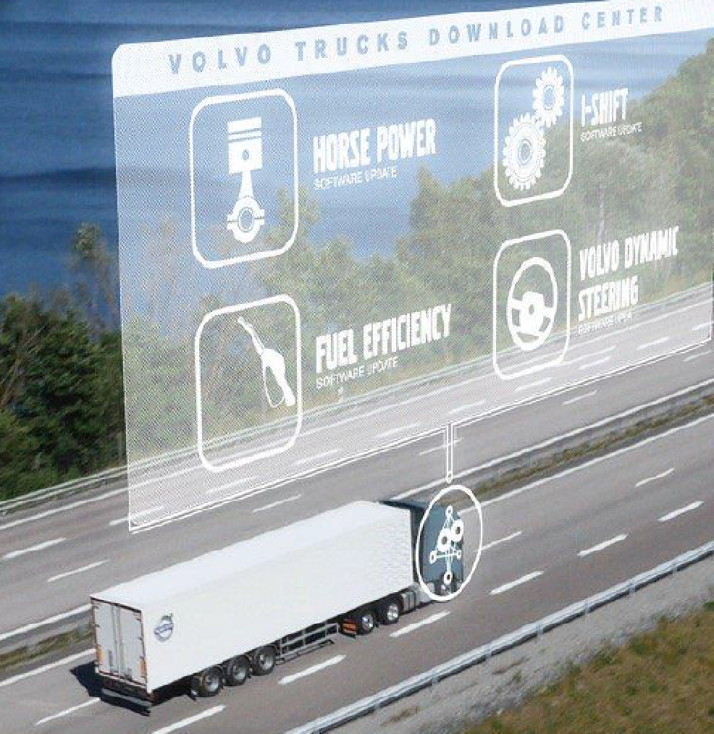
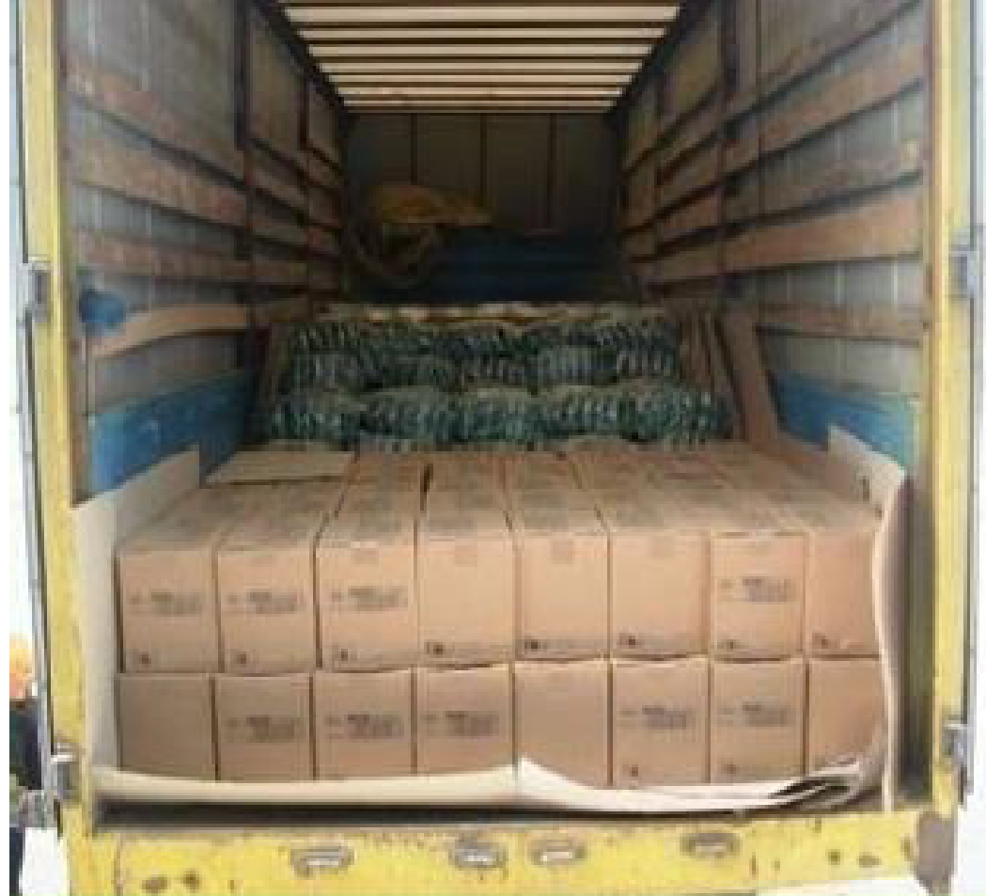
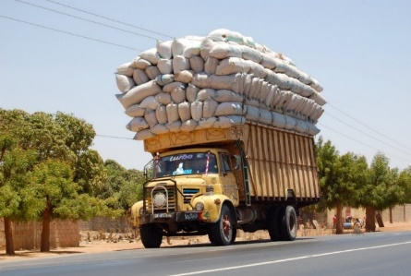
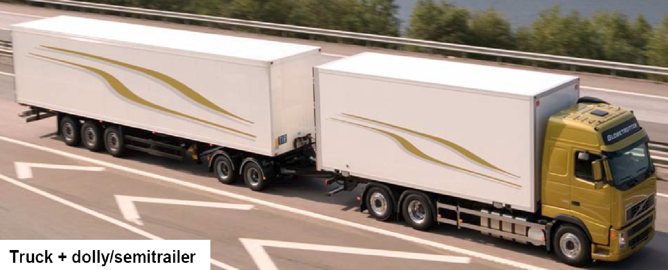
3. Optimise the Utilisation of Vehicle Capacity
large potential CO₂ savings
low or negative carbon mitigation costs
short-medium term implementation
empty running
ways of raising vehicle load factors
Logistical collaboration
EU (2018) 20% (Eurostat)
US (2016) 21% (ATRI)
Latin America 30-50% (IDB)
online procurement
intelligent vehicles
Digitalisation
under-loading
over-loading
High capacity transport
Lack of statistics to monitor trends in vehicle utilisation and assess potential CO₂ savings
Relaxation of JIT ?
‹#›

Slide 12
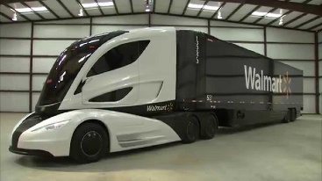
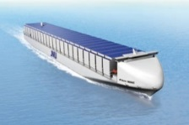
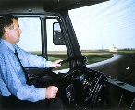
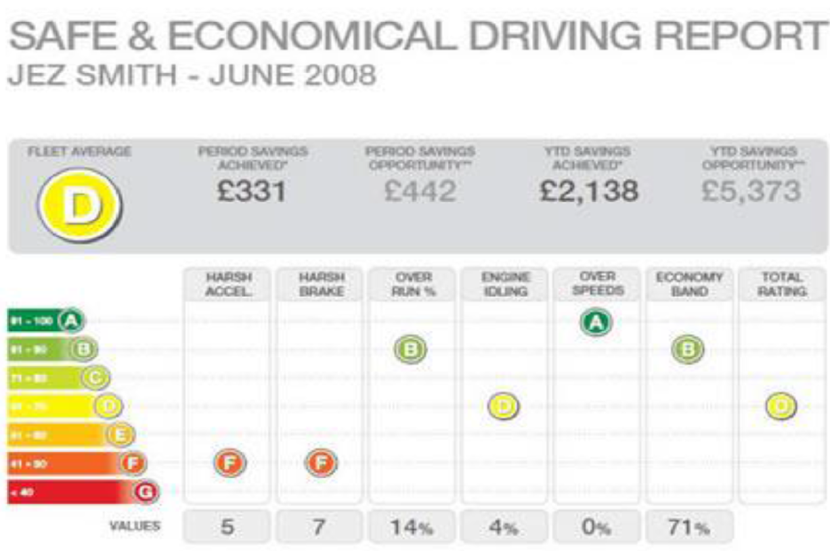
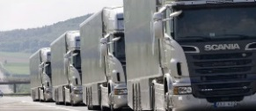
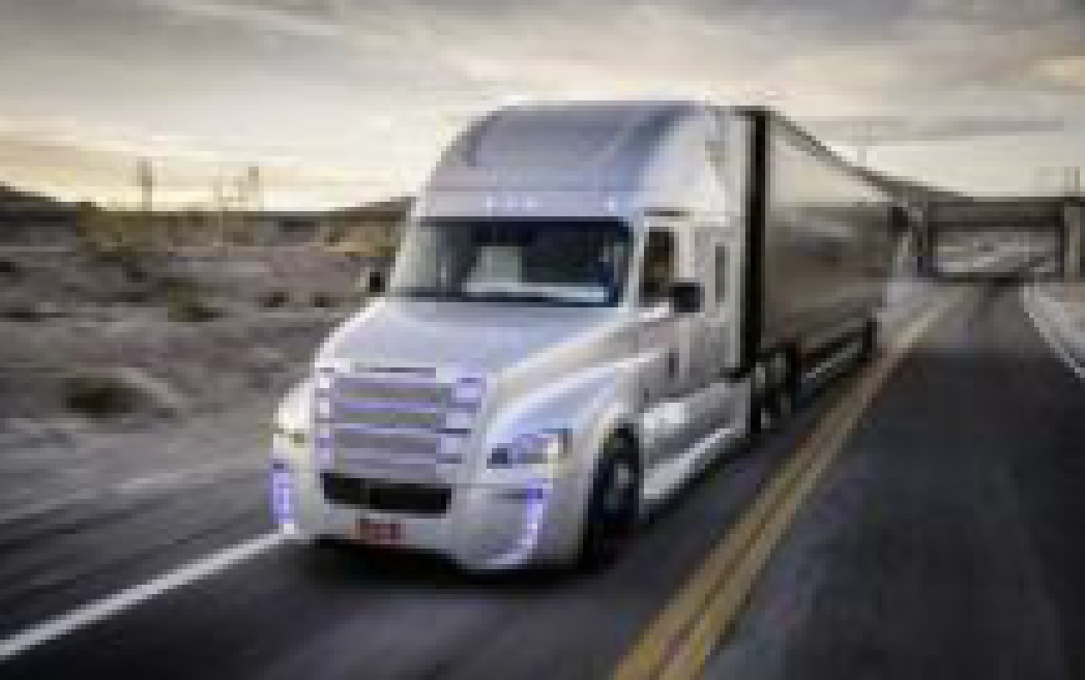
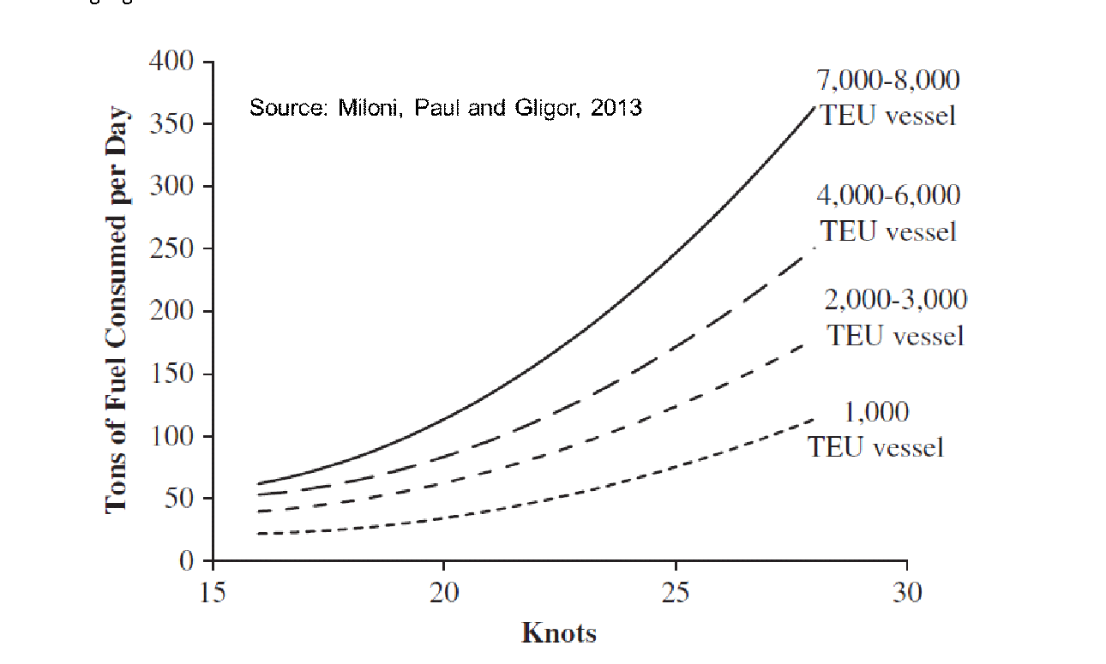
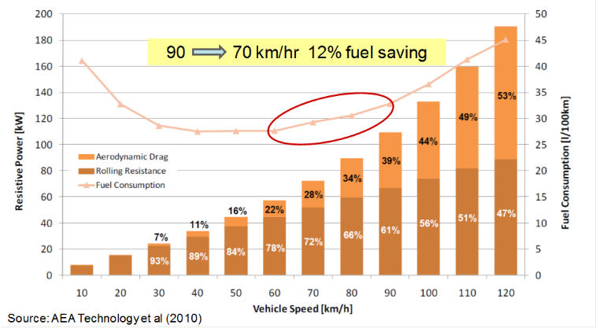
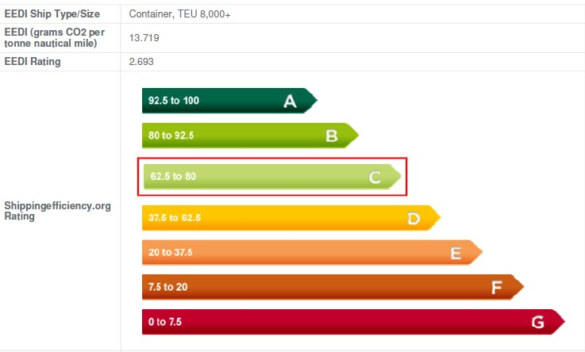
4. Increase the Energy Efficiency of Freight Movement
longer term
short term
uptake of new technologies
retrofitting fuel saving devices
vehicle operation: IT , training, monitoring
eco-driver training
telematic monitoring
platooning
automation
enhanced vehicle maintenance
fuel economy standards: applied to trucks and ships
changes to business practice: e.g. deceleration
70% of new truck sales in 2019 were in countries with fuel economy standards (IEA, 2020)
shipping
trucking
ship energy efficiency ratings
EEDI for new vessels
EEXI for existing vessels
Wider case for supply chain deceleration ?
https://bit.ly/2AW0un9

Slide 13
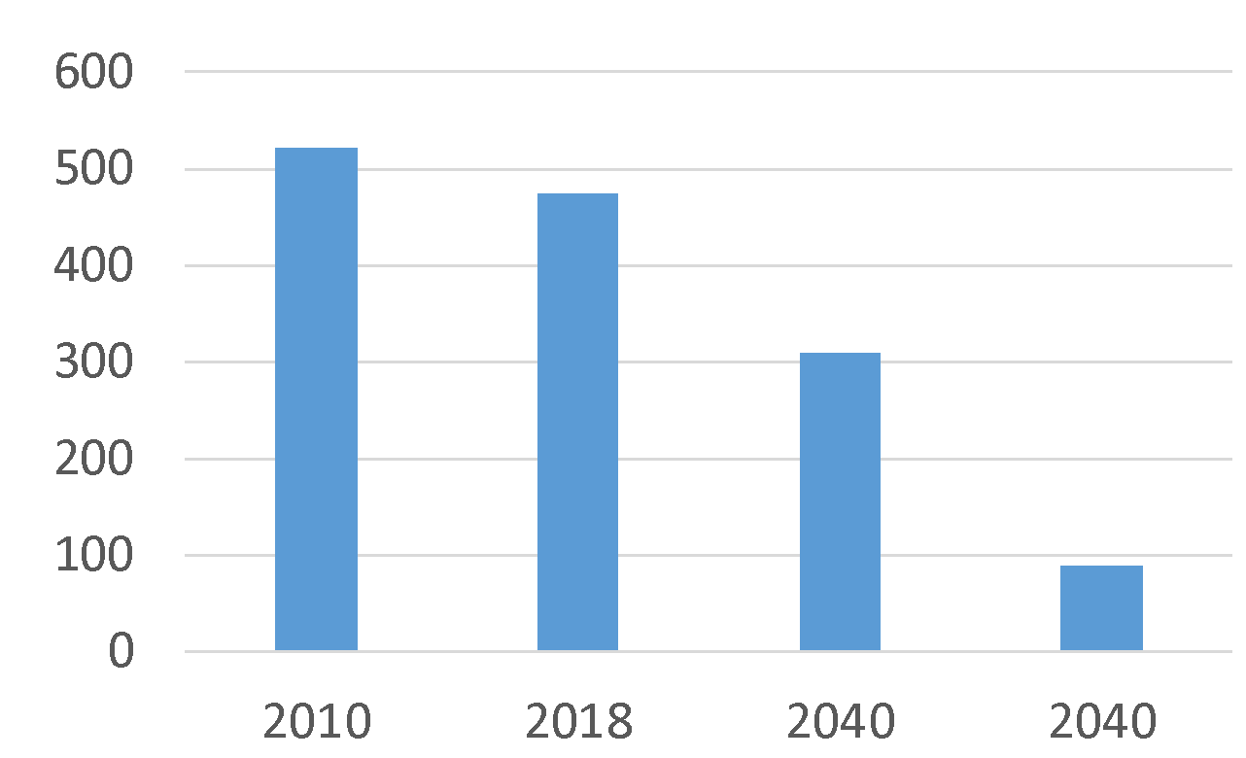
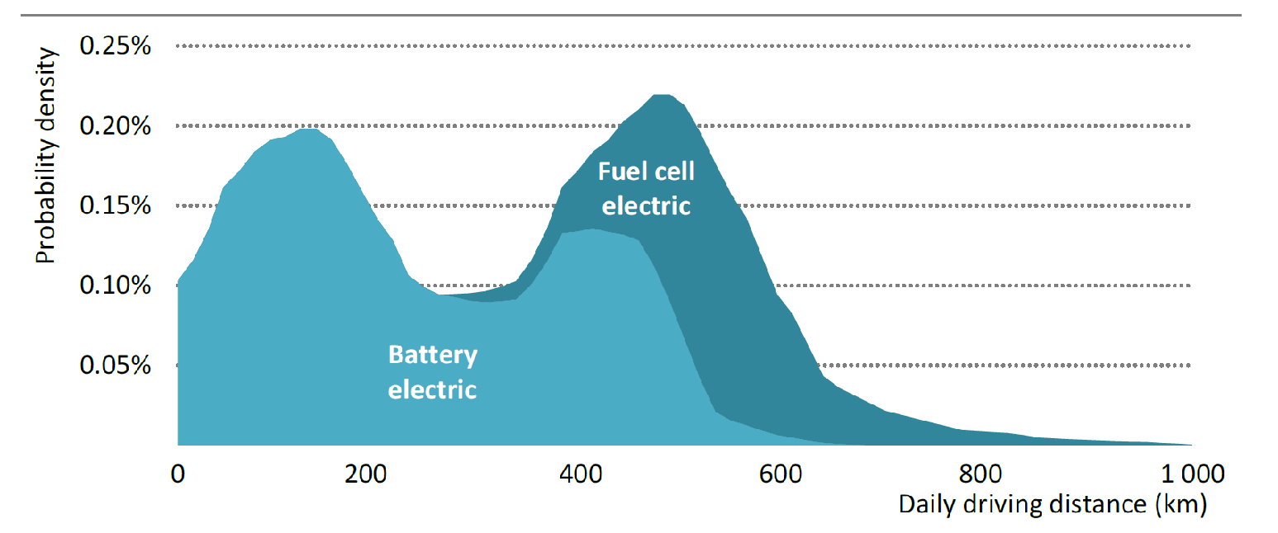
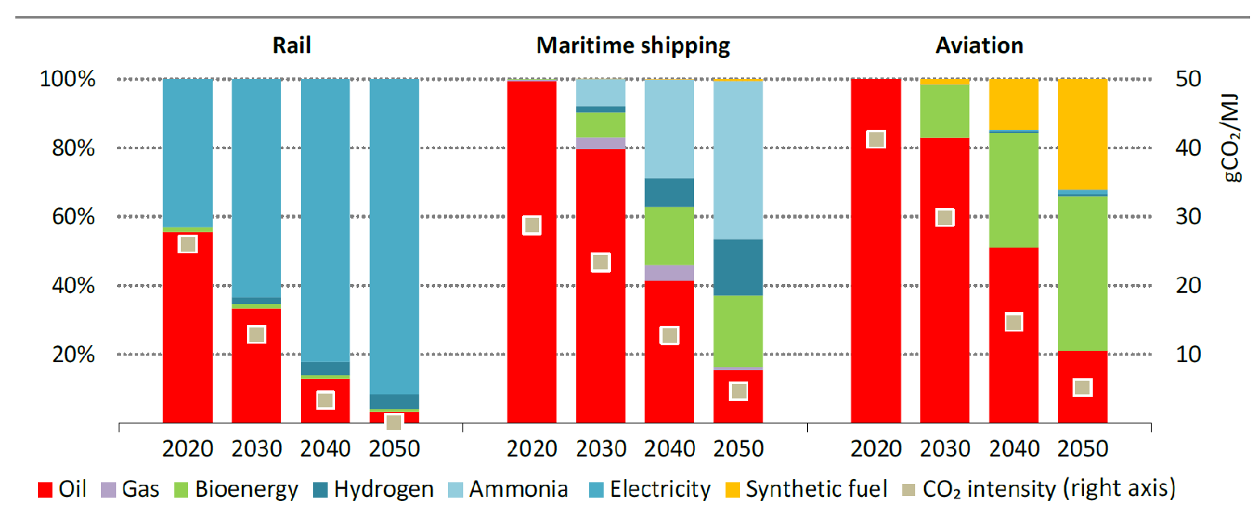
5. Cut the Carbon Content of Freight Transport Energy
low carbon energy options
dependence on the decarbonisation of electricity generation
short haul road | long haul road | rail | shipping | airfreight
battery | battery | catenary | ammonia | biofuel
hydrogen | hydrogen | battery | methanol | synfuel
 | catenary | hydrogen | hydrogen | hydrogen
 | biogas |  | battery | battery
 | synfuel |  | wind
gCO₂ / kWh
-10%
Stated Policies
-32%
Sustainable Development
scenario
IEA 2050 Net Zero Emission Scenario
https://bit.ly/2ZKjrWH
Source: International Energy Agency (2019)
challenges
high fragmentation and under-capitalisation of the road freight sector
coordinating development of transport and energy infrastructures with manufacture of new low carbon freight vehicles, vessels, locomotives etc
competition between freight transport and other activities for available supplies of low carbon energy
diffusion of low carbon freight transport technologies to less developed countries

Slide 14
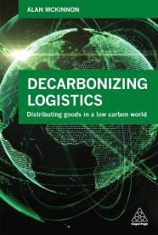
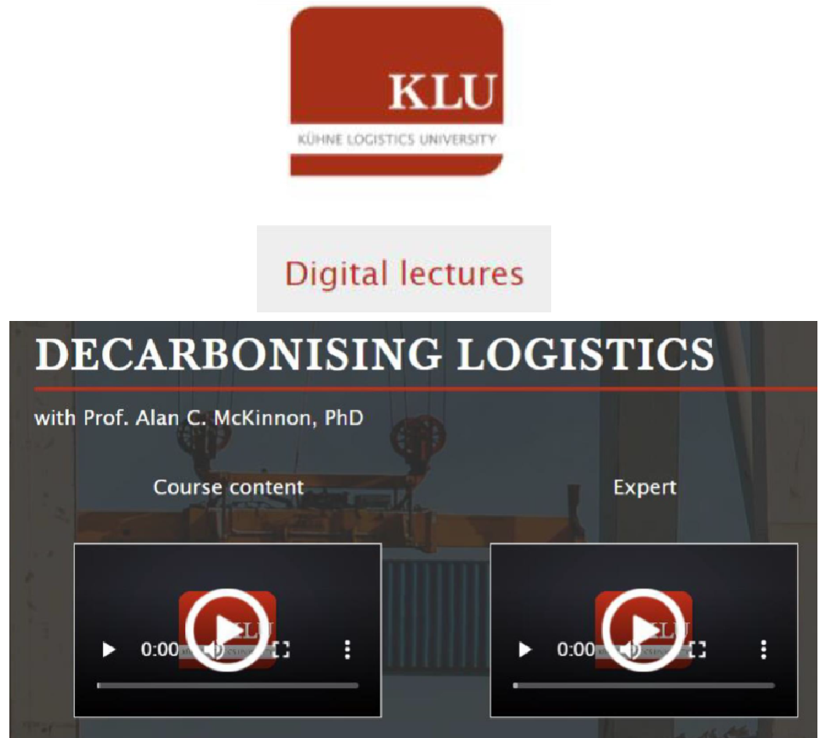
Center for Sustainable Logistics and Supply Chains Kühne Logistics University – the KLU Wissenschaftliche Hochschule für Logistik und Unternehmensführung Grosser Grasbrook 17 20457 Hamburg tel.: +49 40 328707-271 fax: +49 40 328707-109 e-mail: Alan.McKinnon@the-klu.org website: www.the-klu.org www.alanmckinnon.co.uk
Professor Alan McKinnon
@alancmckinnon
www.linkedin.com/in/alan-mckinnon-a3a79722
https://bit.ly/3CkUQWc
Notes:
‹#›

Slide 15
3. How California is Supporting
the Decarbonisation of Freight Transport?
Sydney Vergis
Division Chief, California Air Resources Board.

Slide 16
Decarbonizing Freight Transportation in California Sydney Vergis, Ph.D Division Chief- Mobile Source Control Division

Slide 17
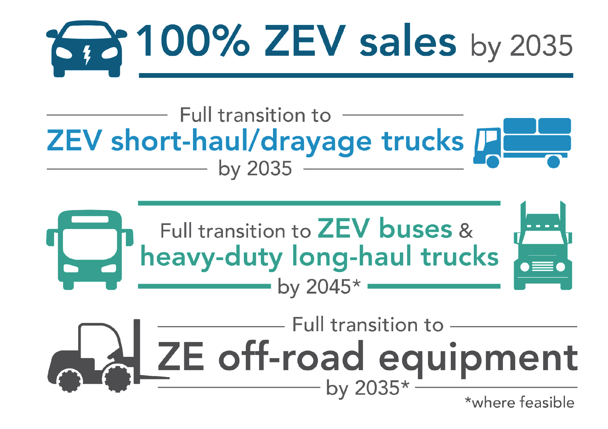
Executive Order N-79-20
Notes:
.

Slide 18
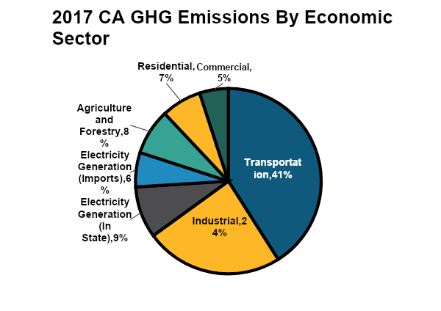
Transportation Is Largest Source of Greenhouse Gases (GHGs) in California

Slide 19
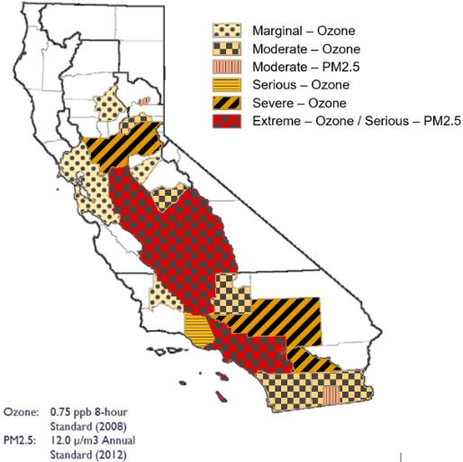
The Air Quality Challenge
California Ozone and PM2.5 Non-Attainment Areas
California has the worst air quality in the United States
Key challenges in southern California
Heavy-duty trucks and federal sources remain largest contributors

Slide 20
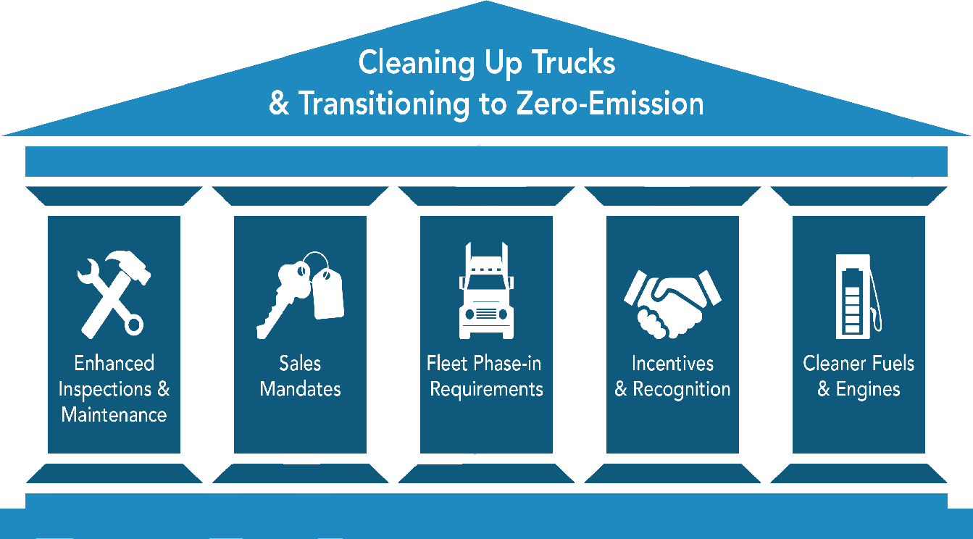

Slide 21
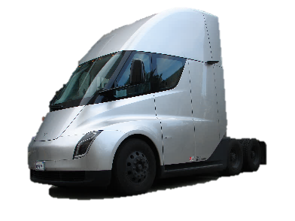
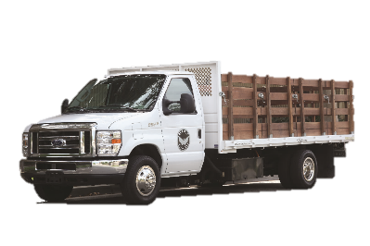
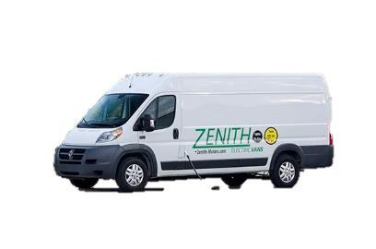
Advanced Clean Trucks
Model Year (MY) | Class 2b-3 | Class 4-8 | Class 7-8 Tractors
2024 | 5% | 9% | 5%
2025 | 7% | 11% | 7%
2026 | 10% | 13% | 10%
2027 | 15% | 20% | 15%
2028 | 20% | 30% | 20%
2029 | 25% | 40% | 25%
2030 | 30% | 50% | 30%
2031 | 35% | 55% | 35%
2032 | 40% | 60% | 40%
2033 | 45% | 65% | 40%
2034 | 50% | 70% | 40%
2035+ | 55% | 75% | 40%
Approved June 2020
Percent of manufacturer sales in California must be ZEV
Flexibility to shift sales among categories
Banking and trading

Slide 22
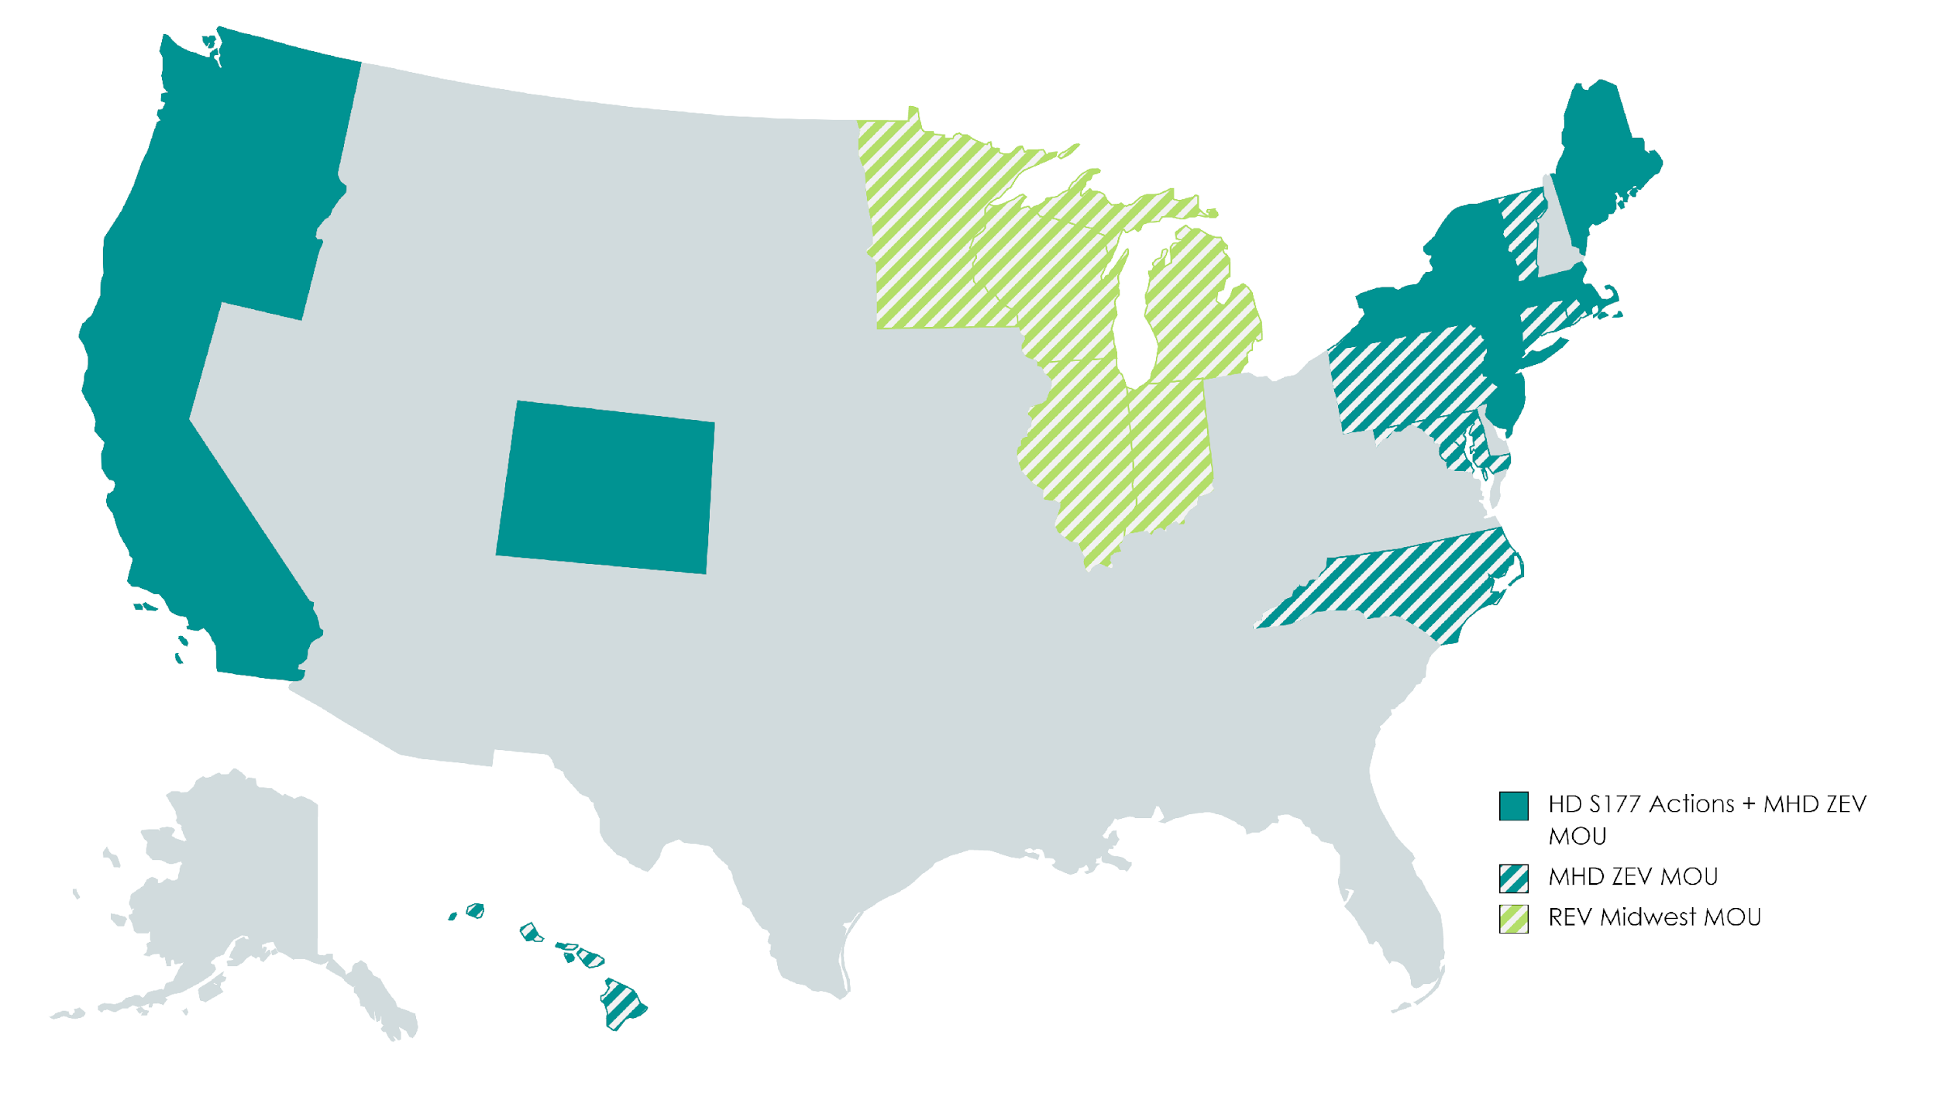
Multistate ZEV Truck Targets
15 states and the District of Columbia MOU
7 states actively working on ACT policy
Notes:
Sets ZEV sales targets
30% sales by 2030
100% sales by 2050

Slide 23
Advanced Clean Fleets
Board consideration: 2022
General Scope:
Public fleets; Drayage trucks; Federal and high priority fleets Fleet requirements for use of ZEVs
Concept
Initial focus on truck types and use cases that are most suitable
Target largest fleets and business for early deployment
100% by 2040 manufacturer sales mandate

Slide 24
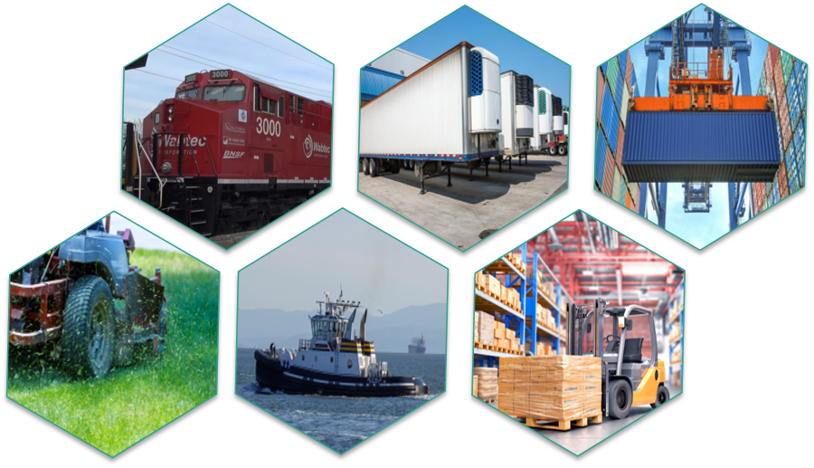
Off-road Vehicles & Equipment Operations
Executive Order N-79-20 requires this sector to transition to 100 percent zero emission by 2035
Transport Refrigeration Units
Locomotives
Cargo Handling Equipment
Small Offroad Engines (SORE)
Forklifts
Commercial Harbor Craft

Slide 25
Additional Policies and Efforts
Zero Emission Budget package
1,150 ZE Drayage trucks and infrastructure
1,000 ZE school buses and infrastructure
1,000 ZE transit buses and infrastructure
Heavy duty demonstration projects
Off road equipment funding
International partnerships

Slide 26
Thank you

Slide 27
4. Transforming Supply Chains -
Insights from Working with Shippers
Yann Briand
IDDRI Transforming Supply Chains

Slide 28
Companies and carbon neutrality, a story of systemic transformations and cooperation: Illustration of the freight transport sector
Movin’On Community of Interest on how the business community can support freight transport decarbonization in the perspective of the UNFCCC Global Stocktake and the revision of Nationally Determined Contributions (NDCs) by 2025

Slide 29
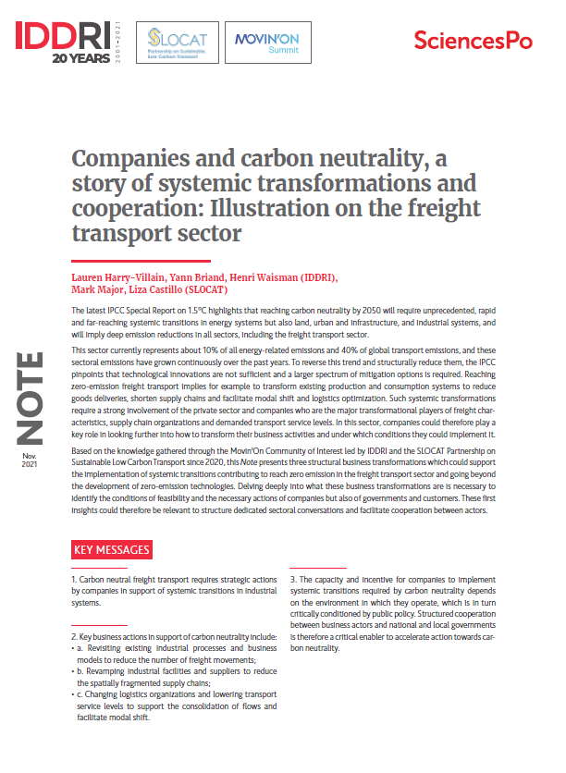
Brief just released last week !
Available online
iddri.org

Slide 30
Key messages
Carbon neutral freight transport requires strategic actions by companies in support of systemic transitions in industrial systems (setting the demand characteristics).
Key business actions in support of carbon neutrality include:
Revisiting existing industrial processes and business models to reduce the number of freight movements
Revamping geographically industrial facilities and suppliers to reduce the spatially fragmented supply chains
Changing logistics organisations and lowering transport service levels to support the consolidation of flows and facilitate modal shift
The capacity and incentive for companies to implement systemic transitions required by carbon neutrality depends on the environment in which they operate, which is in turn critically conditioned by public policy. Structured cooperation between business actors and national and local governments is therefore a critical enabler to accelerate action towards carbon neutrality.

Slide 31
Message 1 - Carbon neutral freight transport requires strategic actions by companies in support of systemic transitions in industrial systems.
Our reasoning
REACHING CARBON NEUTRALITY
Carbon neutrality by mid-century → “deep emission reductions in all sectors”, “unprecedented, rapid and far-reaching systemic transitions” (SPM, IPCC, Special Report 1.5)
REACHING ZERO EMISSION FREIGHT TRANSPORT
Freight sector = 10% of all energy-related emissions and growing continuously
Most existing strategies consider only “supply-side mitigation options”; technological innovations not sufficient to decarbonize: larger spectrum of mitigation options required
SYSTEMIC TRANSFORMATIONS
In order to reach zero emission freight transport : transforming existing production and consumption systems to reduce goods deliveries, shorten supply chains, facilitate modal shift and logistics optimization
PRIVATE SECTOR INVOLVEMENT
Companies, especially shippers, are emerging as key actors to decarbonize freight: net-zero corporate commitments increased including scope 3; hold key levers: freight characteristics, supply chain organisations and demanded transport service levels

Slide 32
Message 2 - From first conversations with companies, three key business actions in support of carbon neutrality have emerged
1. Revisiting existing industrial processes and business models
Integrating environmental & climate impact and reaching carbon neutrality
MOVING AWAY FROM business strategies which contributed to overconsumption of raw materials | TO an industrial system with less material consumption and low-impact products & services
Role of companies | Completely overhauling business models, design and manufacturing process of products or service and packaging (smaller and lighter; reusable, recyclable and repairable; bio-sourced; new services…)
Systemic effects | General effects: Reduction of energy & materials needed during production Reduction of the number of products, packaging manufactured in the medium to long term as lifespan increases Transport related effects: This will reduce the need for deliveries and related energy consumption, emissions and costs.

Slide 33
Message 2 - From first conversations with companies, three key business actions in support of carbon neutrality have emerged
2. Revamping geographically industrial facilities and suppliers
Integrating environmental & climate impact and reaching carbon neutrality
MOVING AWAY FROM long and scattered supply chains | TO more resilient, socially-responsible and less fragmented supply chains organized around local and regional production-consumption hubs
Role of companies | Moving processes’ steps depending on market locations; sourcing materials closer to processing sites (-> link with 1); …
Systemic effects | General effects: Supply chain resilience Benefit for regional economies Better acceptability to customers Transport-related effects: Reduce the amount of kilometers travelled by goods and related freight traffic. Reduce the dependency on maritime or aviation transport, facilitate use of terrestrial modes and their electrification

Slide 34
Message 2 - From first conversations with companies, three key business actions in support of carbon neutrality have emerged
3. Changing logistics organisations and lowering transport service levels
Integrating environmental & climate impact and reaching carbon neutrality
MOVING AWAY FROM “just-in-time” logistics organisations (reducing stocks and costs, but increasing service level constraints and energy use) | TO a less flexible and slower transport services (other logistics organisations where all energy efficiency measures are included)
Role of companies | Revising the stock management strategy and product availability (expanding stock, losing a bit in flexibility, changing warehouses’ positions; revising relationships with customers (slowing down; less deliveries); …
Systemic effects | General effects: Facilitate collaboration among players and consolidation of flows Transport-related effects: Logistics and transport service providers could therefore offer new options to decarbonise freight transport (modal shift, vehicle capacity optimization)

Slide 35
3 - Structured cooperation is essential
1. Companies will contribute to the global efforts towards carbon neutrality but need to get prepared for the transformations of our economies and clarify what it will imply.
But, companies cannot do it alone : they are embedded in market rules and specific economic, social, geographical and political national contexts.
2. Companies can play a major role in the identification of barriers and solutions to implement these systemic transformations required by carbon neutrality.
Key inputs for structured dialogues with both national & local governments to advance on the design of coherent and cost effective strategy
3. Developing transport conversations in the perspective of the UNFCCC Global Stocktake is a practical approach to identify priority areas of cooperation and levers of change for more ambitious targets and actions !

Slide 36
How to take this discussion forward?
Next steps:
Analyse the required business transformations, motivations, consequences and conditions of feasibility to reach zero emission freight transport and carbon neutrality;
Establish sectoral conversations with policy makers and other stakeholders around these analyses to develop concrete cooperation and coordination of actions;
Please get in touch with us for more information on the community !
yann.briand@iddri.org; lauren.harryvillain@iddri.org
mark.major@slocatpartnership.org; liza.castillo@slocatpartnership.org
Movin’On Community of Interest on how the business community can support freight transport decarbonization in the perspective of the UNFCCC Global Stocktake and the revision of Nationally Determined Contributions (NDCs) by 2025

Slide 37
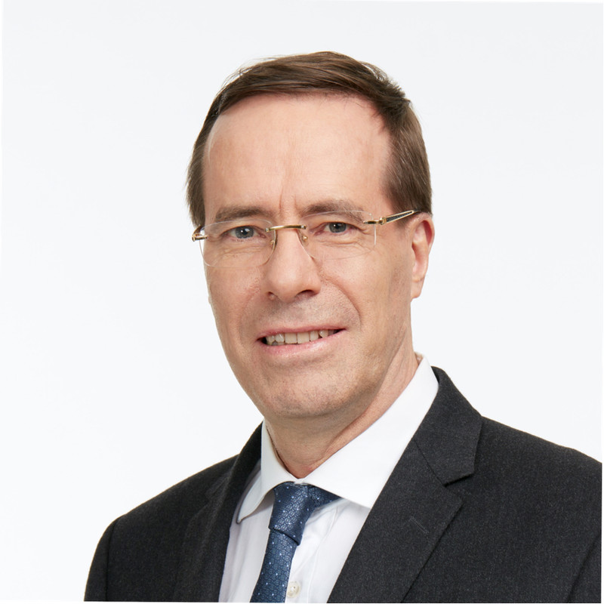
5. Panel Discussion
Nicolas Beaumont
Senior VP Sustainable Development and Mobility, Michelin
Elisabeth Munck Af Rosenschöld
Leading Sustainability in IKEA Supply Chain Operations
Frédéric Delorme
President of Rail Logistics Europe at SNCF, member of 4F - French Rail Freight of the Future

Slide 38
6. Closing remarks

Slide 39
Thank you!

